Slide 1
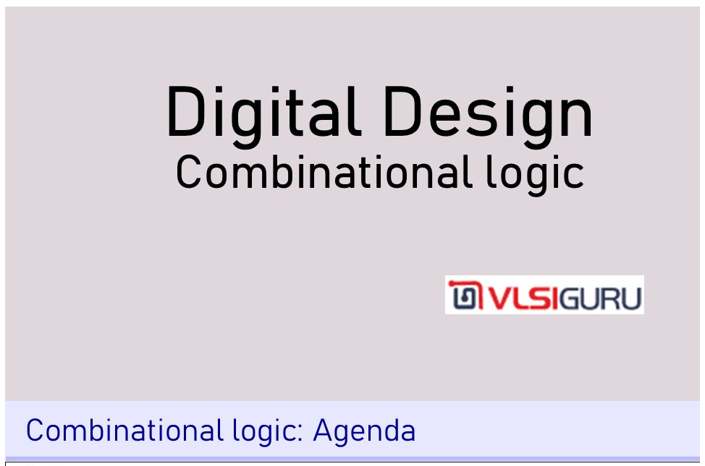

Slide 2
Unit 3: Number system and radix format and hex to binary mapping

Slide 3


Slide 4
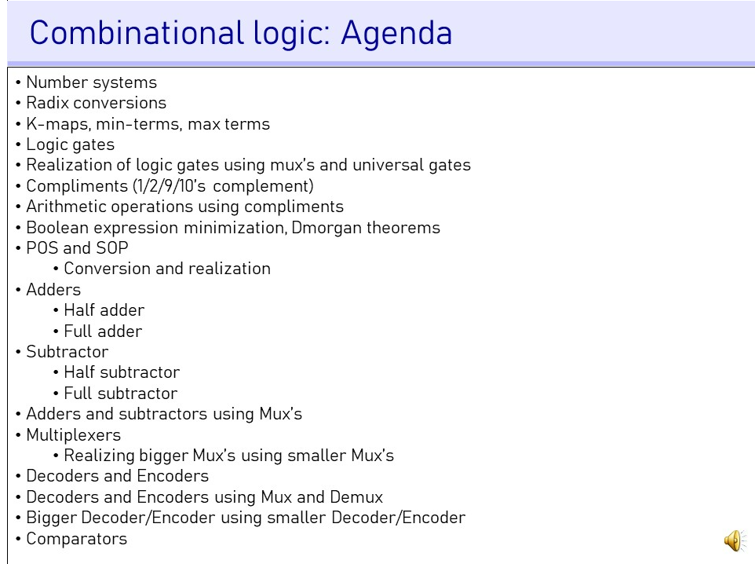

Slide 5
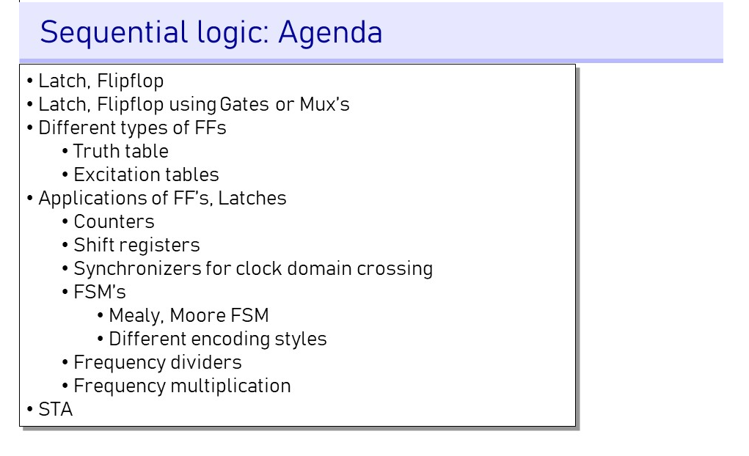

Slide 6


Slide 7
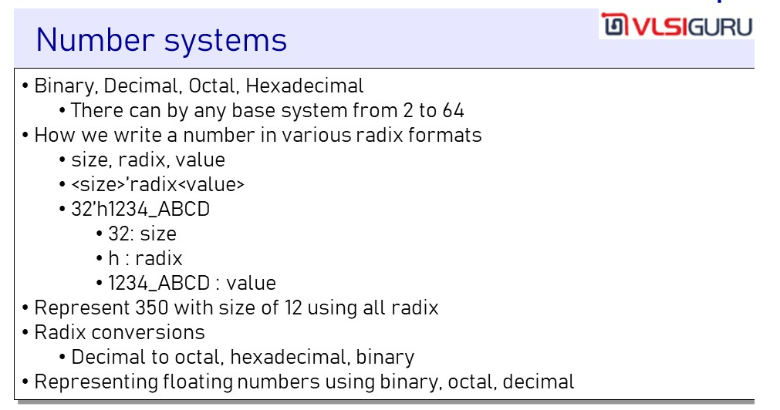

Slide 8
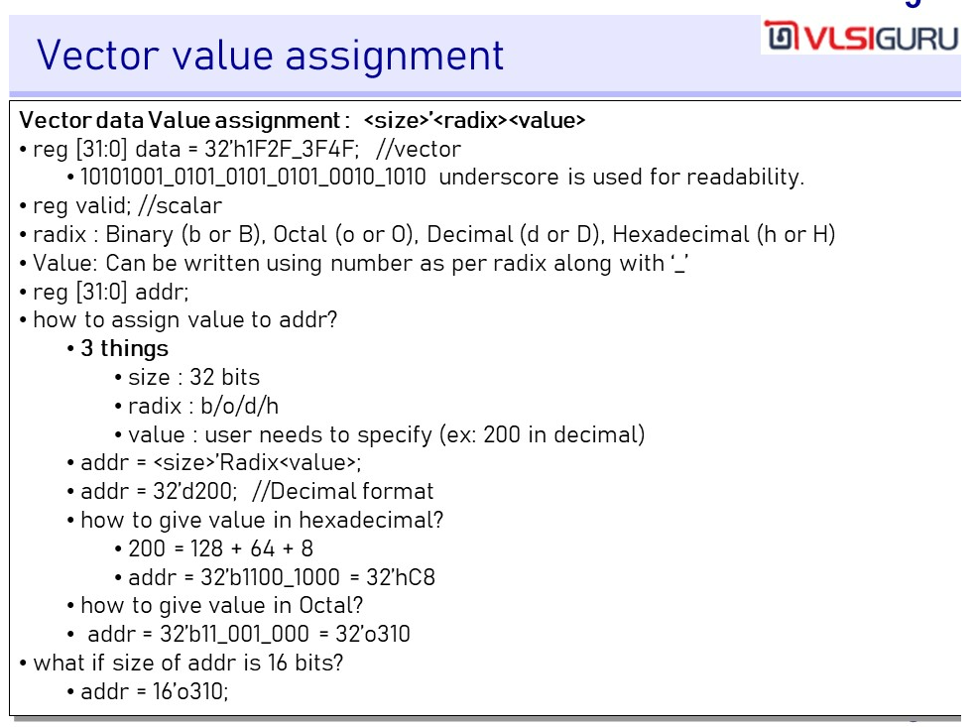

Slide 9


Slide 10
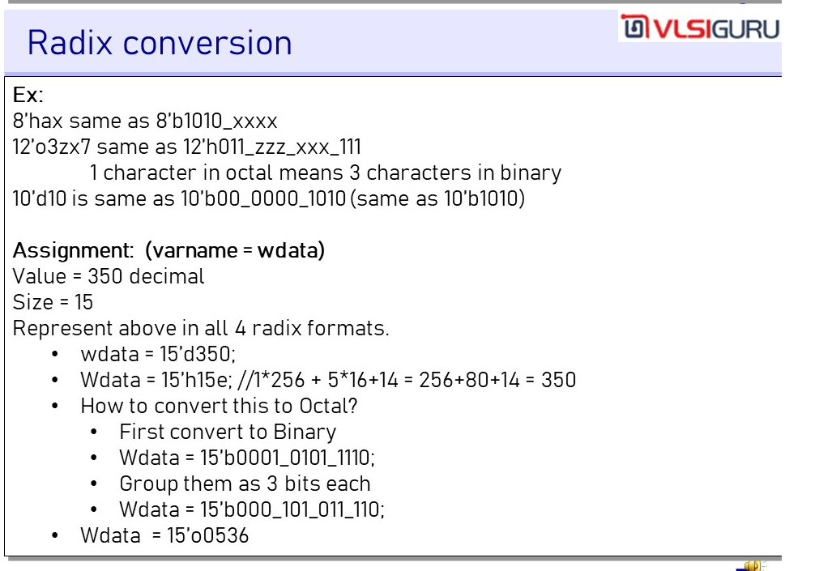

Slide 11
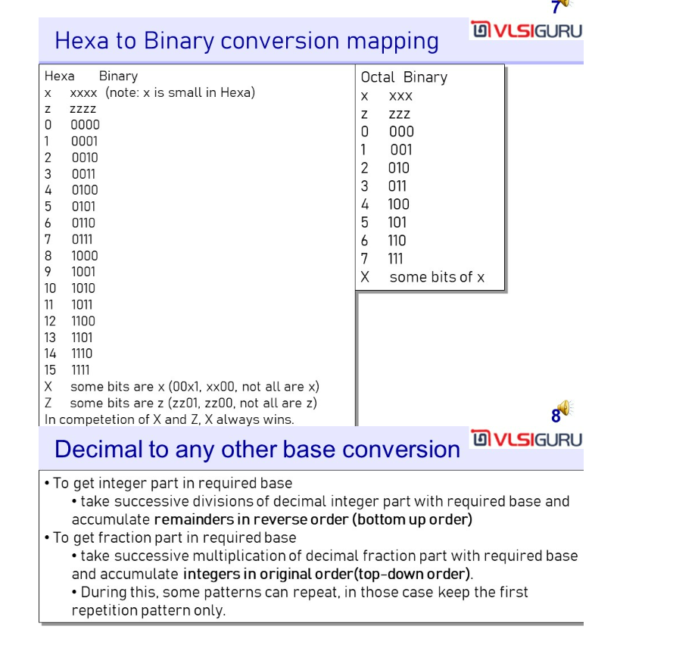

Slide 12
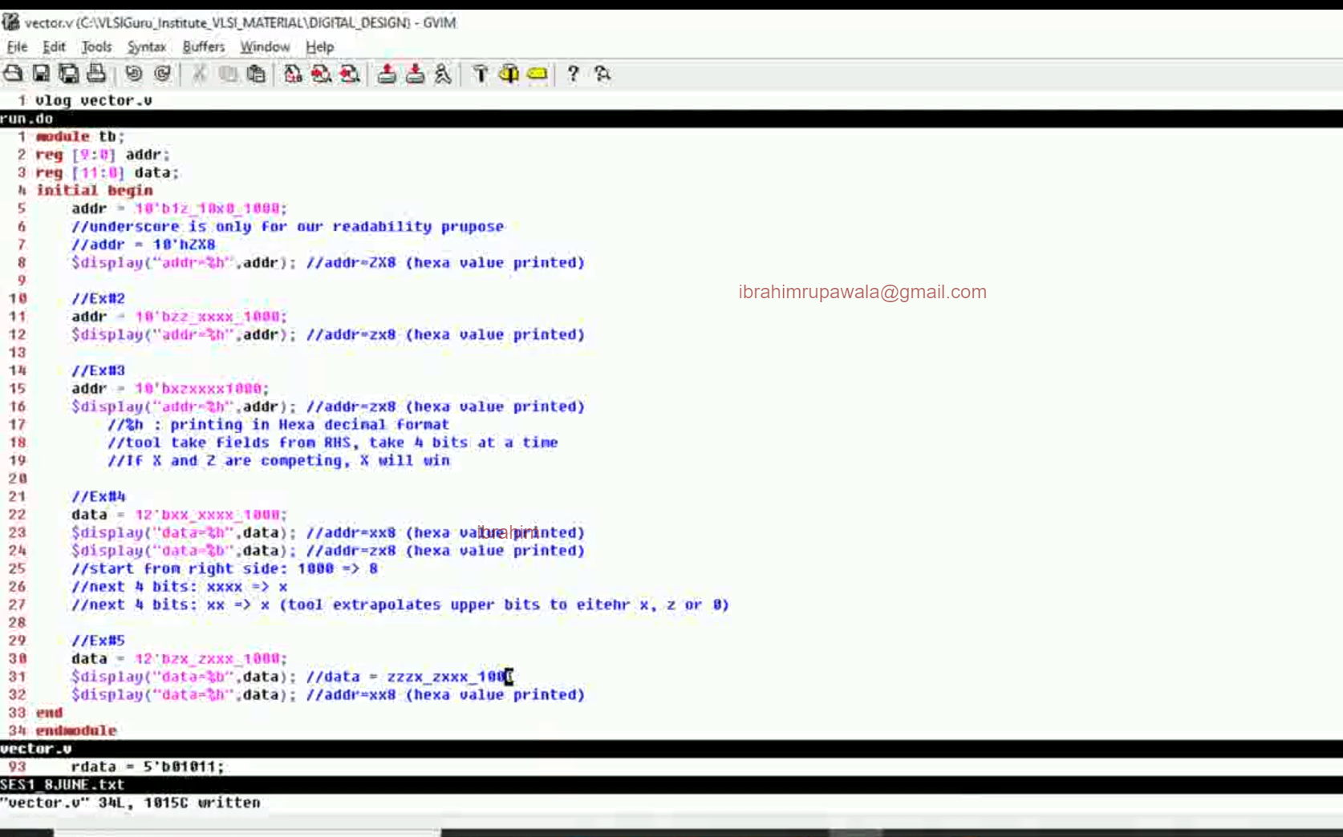


Slide 13


Slide 14
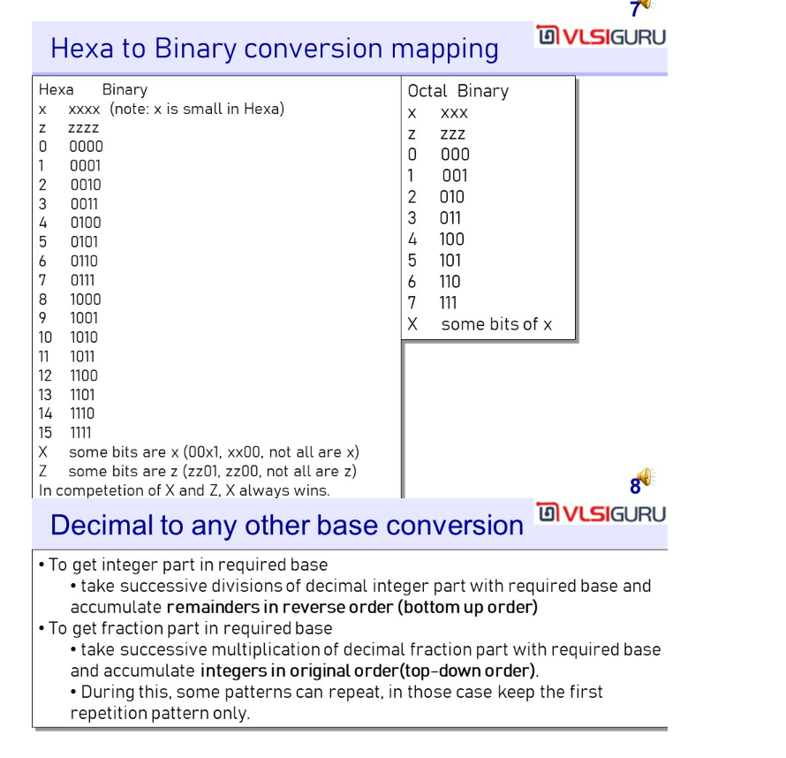

Slide 15
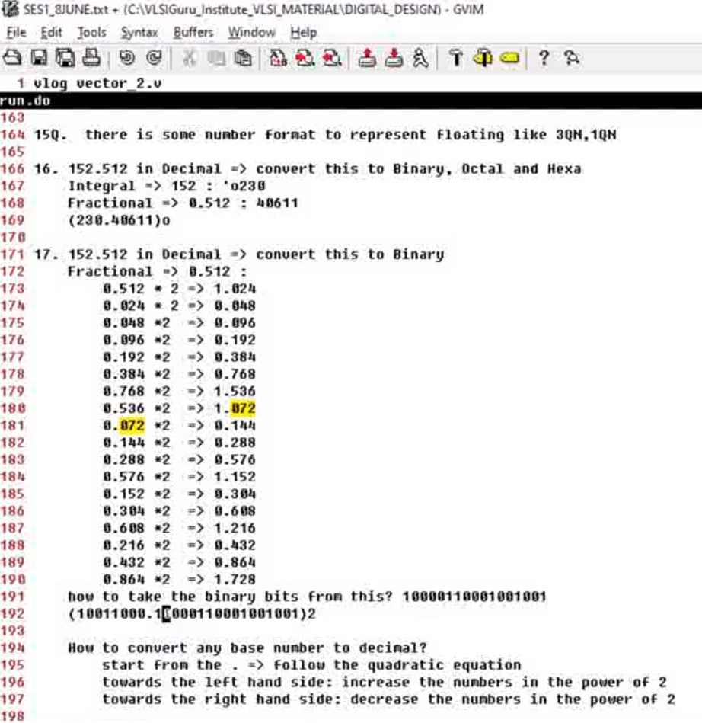
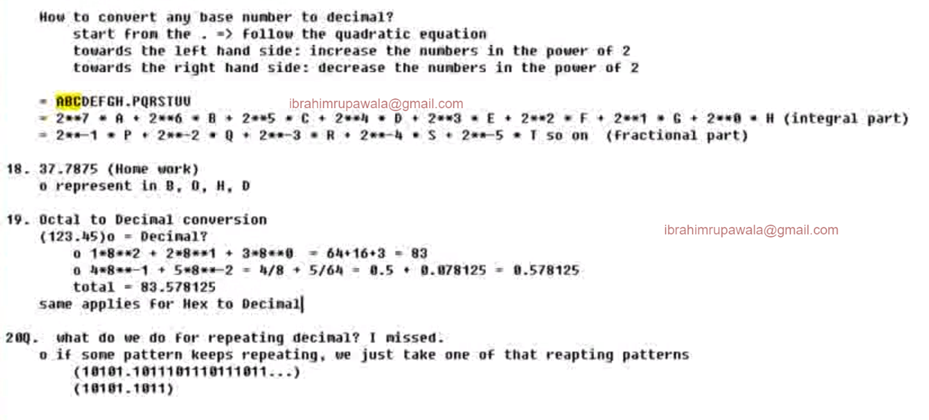
This is very important. See how to represent any base number to decimal

Slide 16
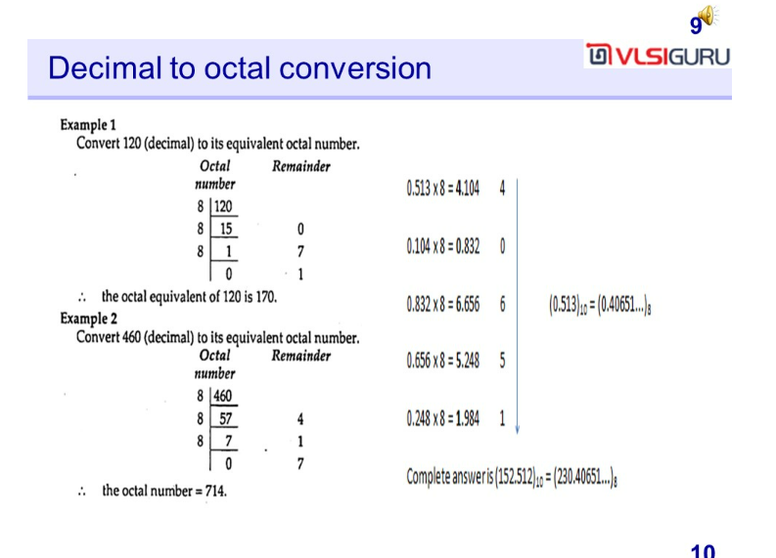

Slide 17
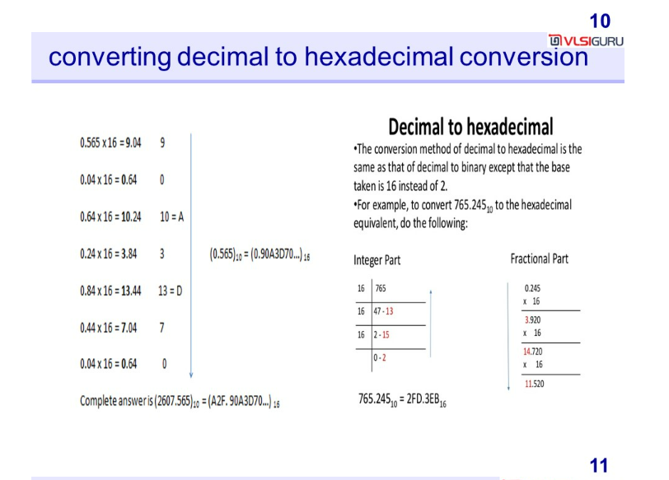

Slide 18
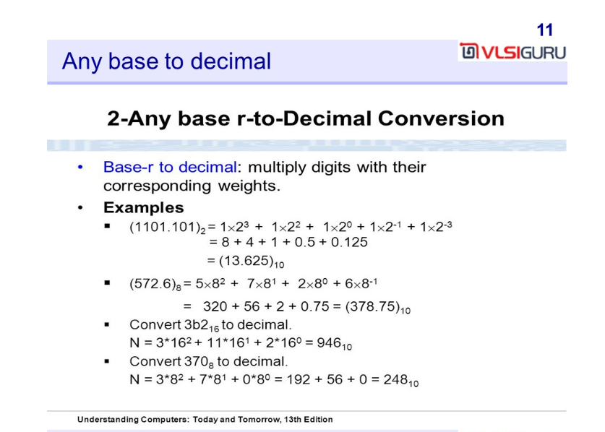

Slide 19
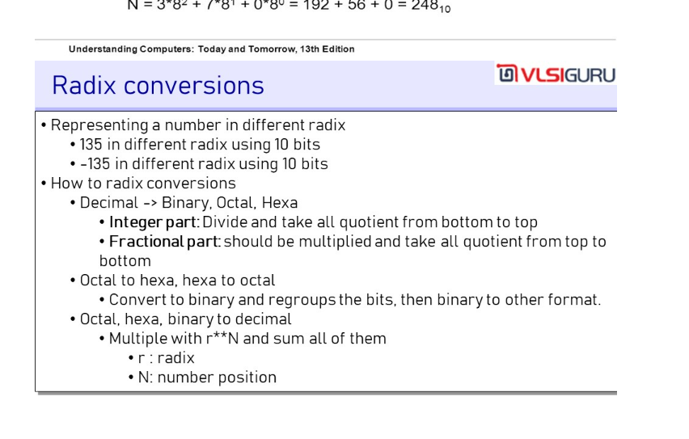
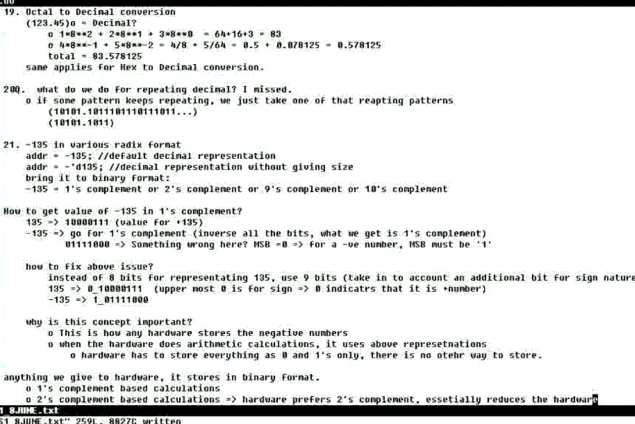

Slide 20
Unit 4: Number of bits required and compliments

Slide 21
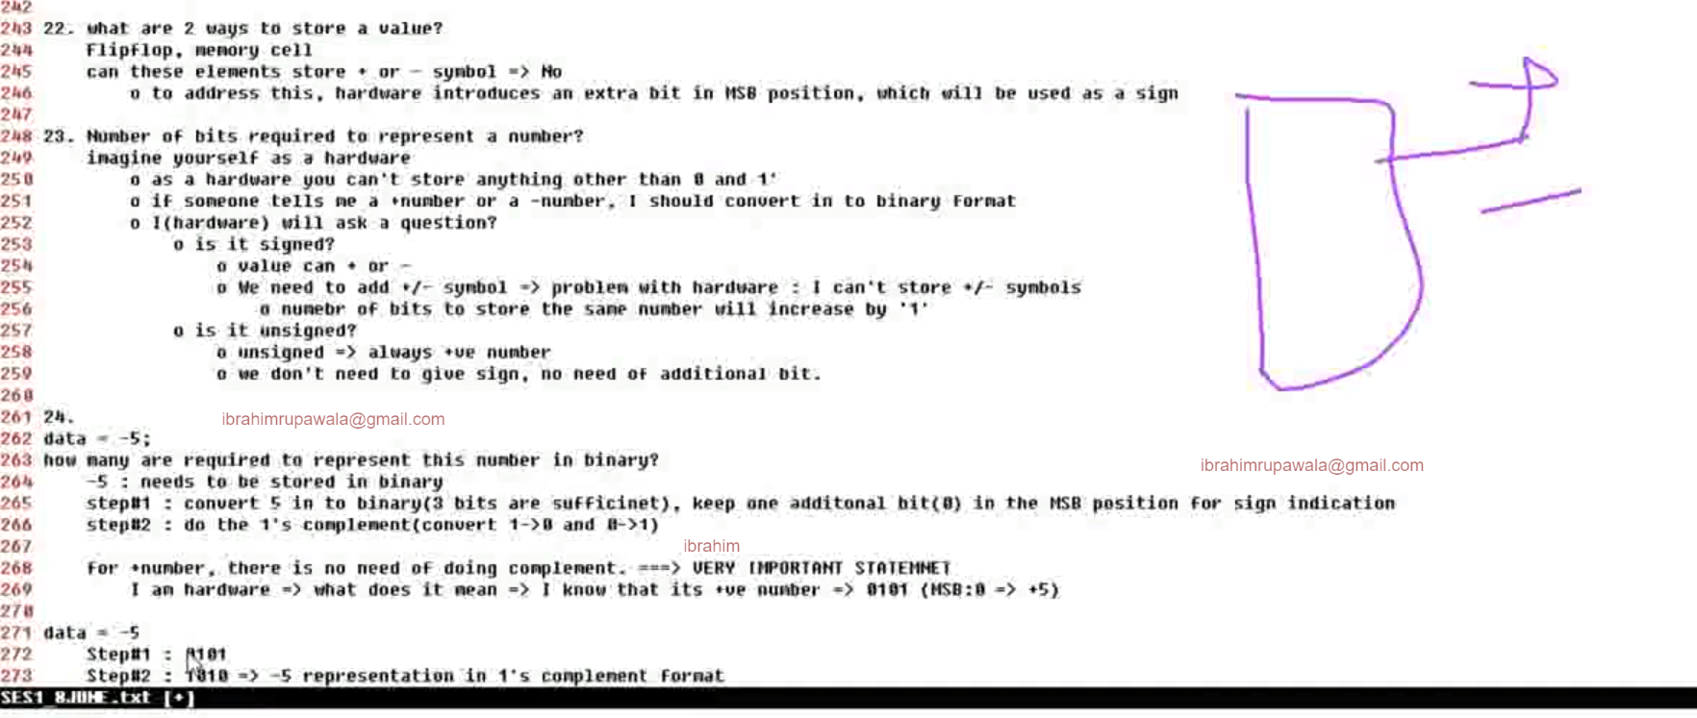
A FF can only store 1 bit, hence 8-bit hardware consist of 8 FF’s.
What are 2 ways to store a value ? – Flipflop and Memory cells.

Slide 22
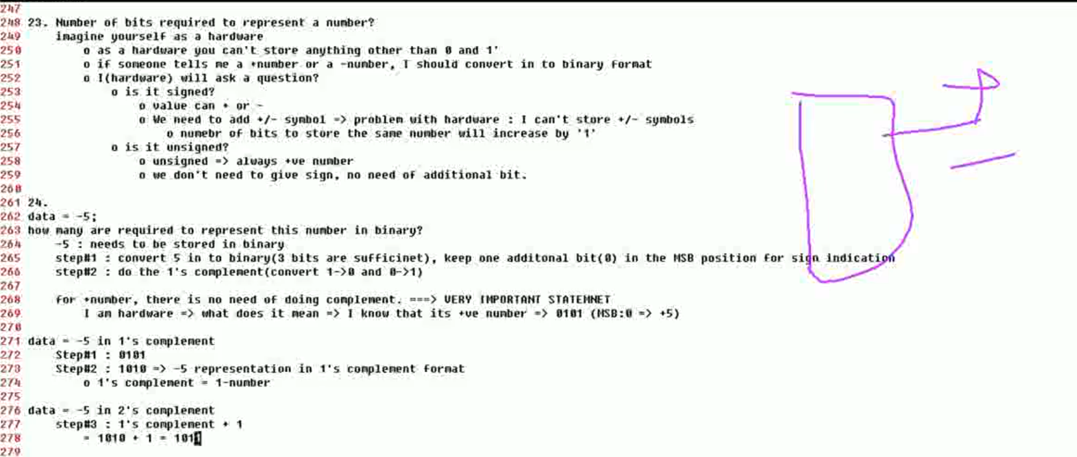

Slide 23
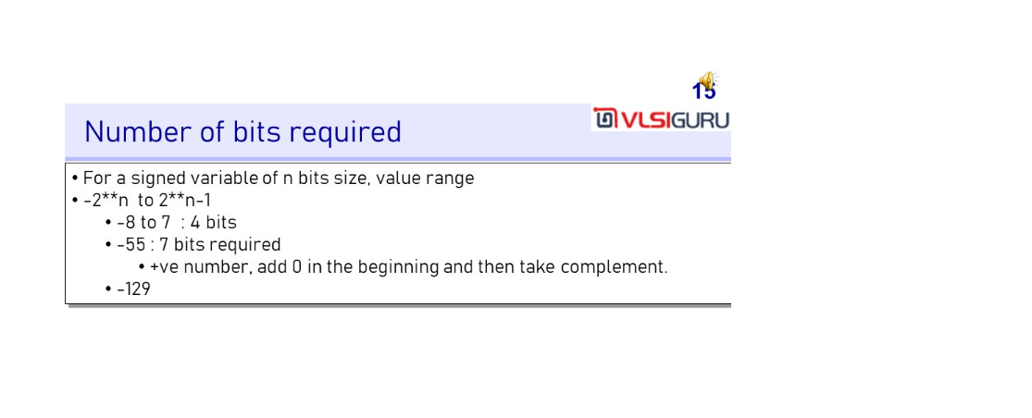
Notice that Verilog stores the number in 2’s complement form

Slide 24
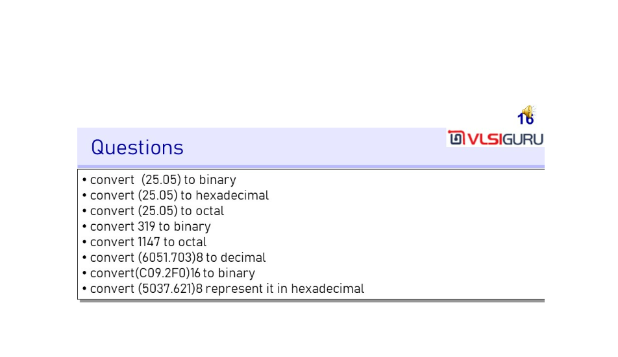

Slide 25
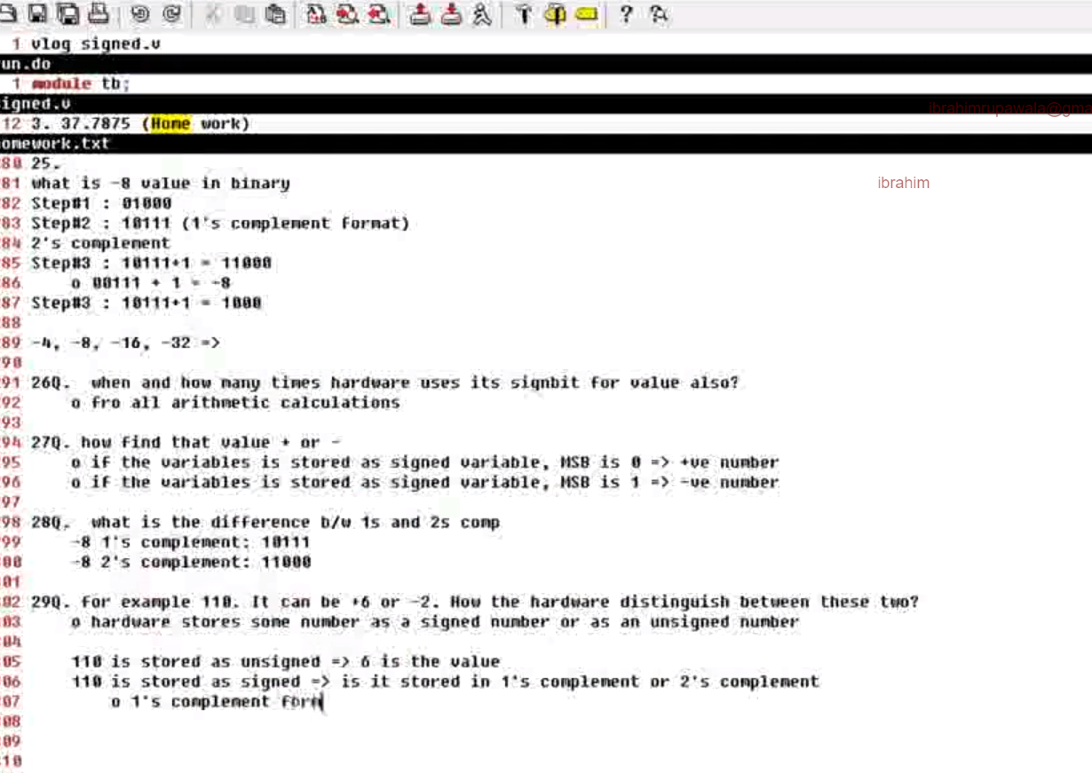
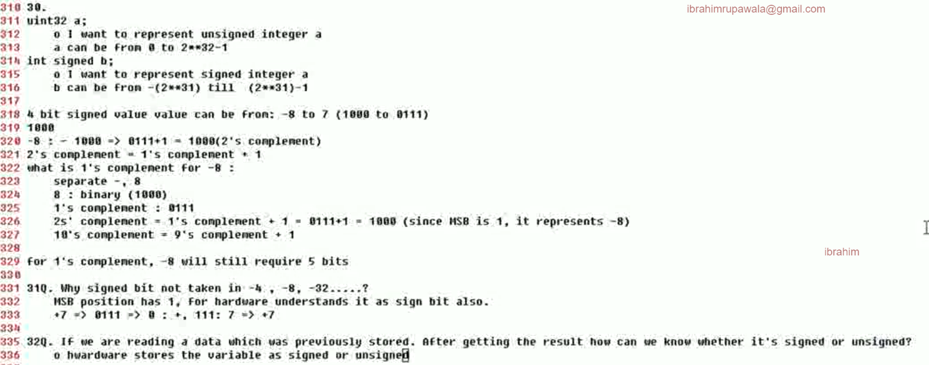

Slide 26
Remember that negative number is stored always in 2’s complement in verilog
// Code your testbench here
// or browse Examples
module tb;
reg signed [2:0] data1;
reg [2:0] data2;
initial begin
data1 = -3'd7; // -4'd6
$display("data1_dec = %d", data1);
$display("data1_bin = %b", data1);
data2 = -3'd7;
$display("data2_dec = %d", data2);
$display("data2_bin = %b", data2);
end
endmodule

Slide 27
When the number is read. If it is signed reg then the Verilog will check MSB, if it is unsigned Verilog will not care about MSB
// Code your testbench here
// or browse Examples
module tb;
reg signed [2:0] data1;
reg [2:0] data2;
initial begin
//data1 = -3'd7; // -4'd6
data1 = 3'b110; // -2
$display("data1_dec = %d", data1);
$display("data1_bin = %b", data1);
// data2 = -3'd7;
data2 = 3'b110; // 6
$display("data2_dec = %d", data2);
$display("data2_bin = %b", data2);
end
endmodule

Slide 28
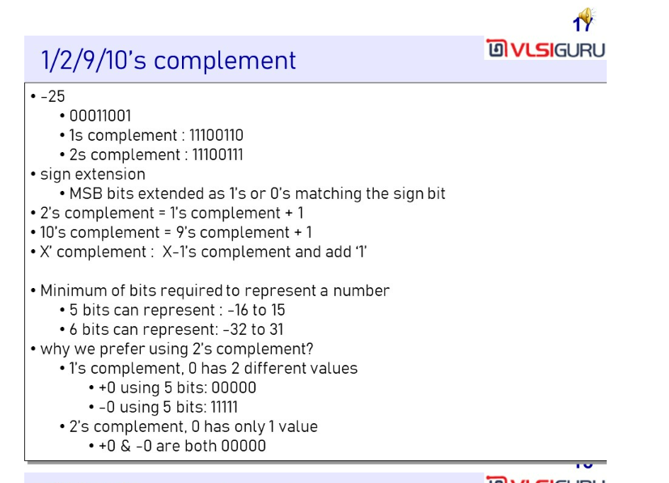

Slide 29
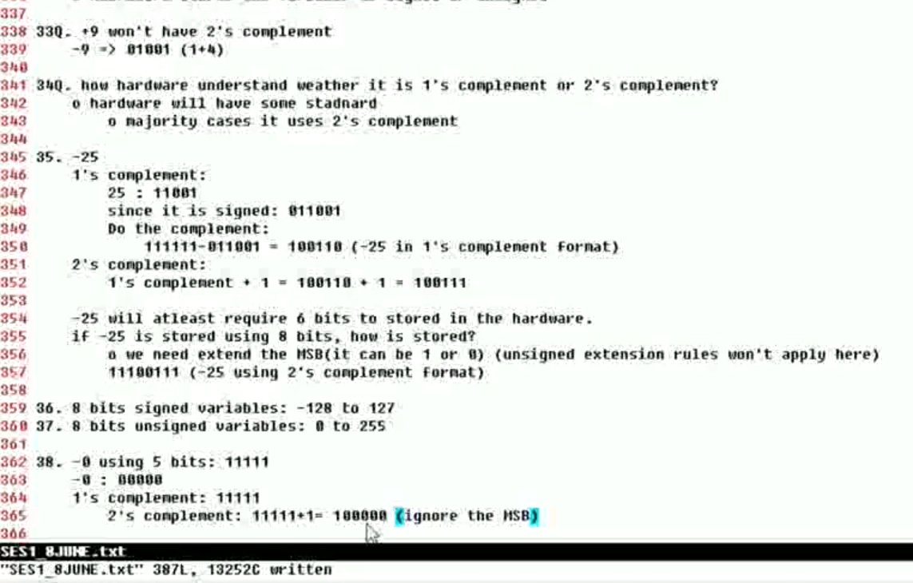
Signed no subtraction - Read Carefully !!

Slide 30
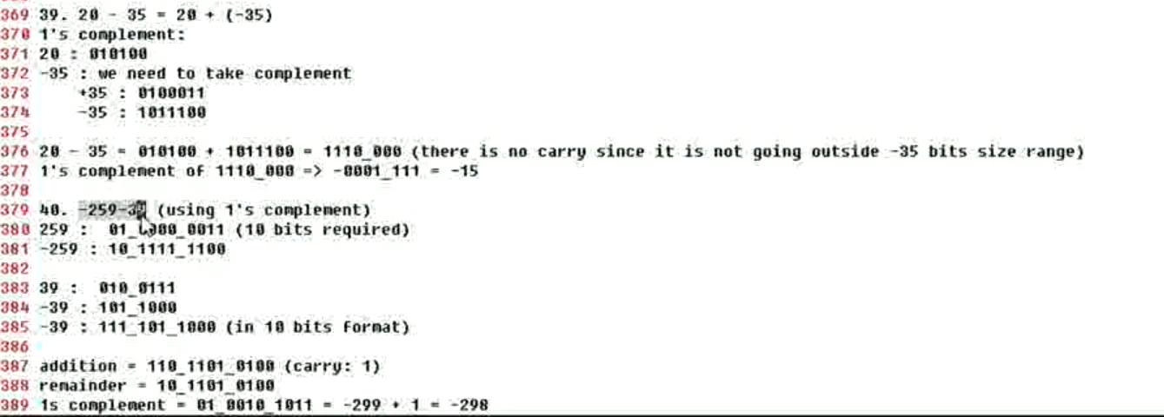
Signed no subtraction - Read Carefully !!

Slide 31
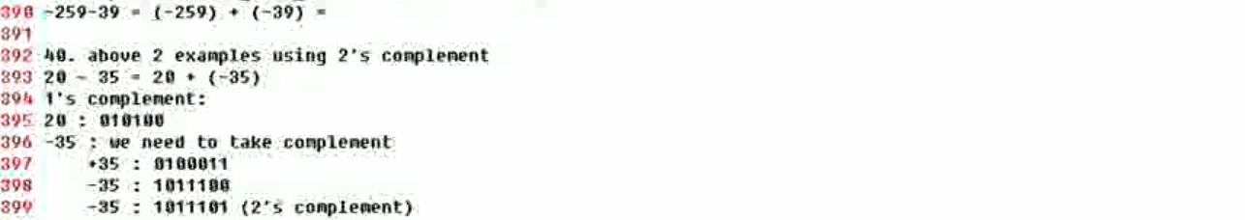
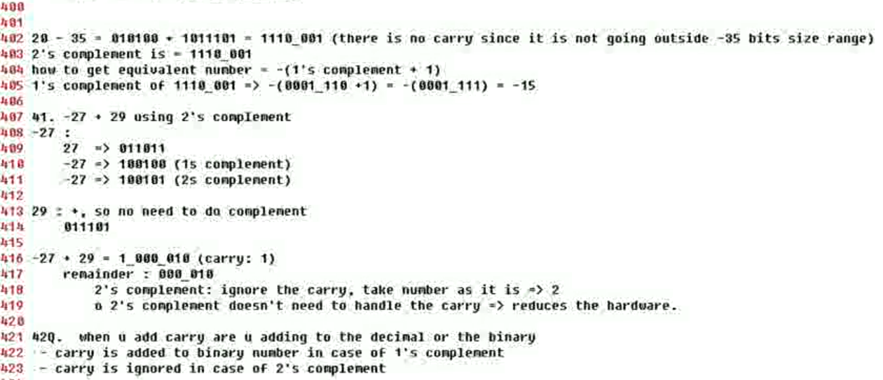
2’s complement ignores the carry hence reduced hardware and hence it is preferred over 1’s complement for arithmetic operations

Slide 32
Useful Links to understand CDC and Two-stage synchronizers
https://www.youtube.com/watch?v=YS-LHzb4djg
https://www.youtube.com/watch?v=fwh-KISWs7c
https://www.youtube.com/watch?v=ovQ5VYlEc8o&t=656s

Slide 33
Mealy and moore diagrams
For mealy = output depends on current state and input, hence it has one state less than moore
For moore = output depends on current state, no of states = no of inputs in the pattern + 1
For moore the output state will be part of a state machine diagram
For mealy output states will not be a part of state machine diagram
For mealy represent both input and output in the state machine arrow from one state to other like 0/1 as output depends on state, in.
For moore represent only input in the arrow as output depends only on state.

Slide 34
K-Maps
https://www.youtube.com/watch?v=lw1STgKUpW0
https://www.youtube.com/watch?v=YxGvrurqSOE
Very important to come up with the Boolean expression from truth table or to reduce the Boolean expression to simplified Boolean.
For SOP, 1 is filled in the k-map while for POS, 0 is filled.
For SOP, 0 in the exp is complement while for POS, 1 is complement.

Slide 35
Linting
Notice that case equality === and logical equality == have different meaning in Verilog. Similarly for != and !==.
== tests logical equality (tests for 1 and 0, all other will result in x)
=== tests 4-state logical equality (tests for 1, 0, z and x)

